Slide 1
Reinforcement Learning with Azure Machine Learning
Mario O. Bourgoin, PhD
12/5/2019
Acknowledgements: Keiji Kanazawa

Slide 2
Learnings
About Azure ML reinforcement learning (RL) module
How to install the module and examples
How to run the examples

Slide 3

Reinforcement Learning
Learning how to act given a situation to maximize rewards
A policy maps situations to actions
The space of policies is huge: ${\text{(}\text{\#}\text{actions}\text{)}}^{\text{(\#}\text{situations}\text{)}}$
Finding a good policy requires exploration/lots of data

Slide 4
Azure ML Reinforcement Learning
Managed RL service for large scale distributed simulation and training, using Ray/RLlib framework
Customers create compute clusters and submit simulation/training jobs using standard Azure ML pattern with SDK & CLI
RL algorithms are in RLlib – Deep training is Tensorflow by default, Pytorch possible
Available in azureml-sdk 1.0.76

Slide 5


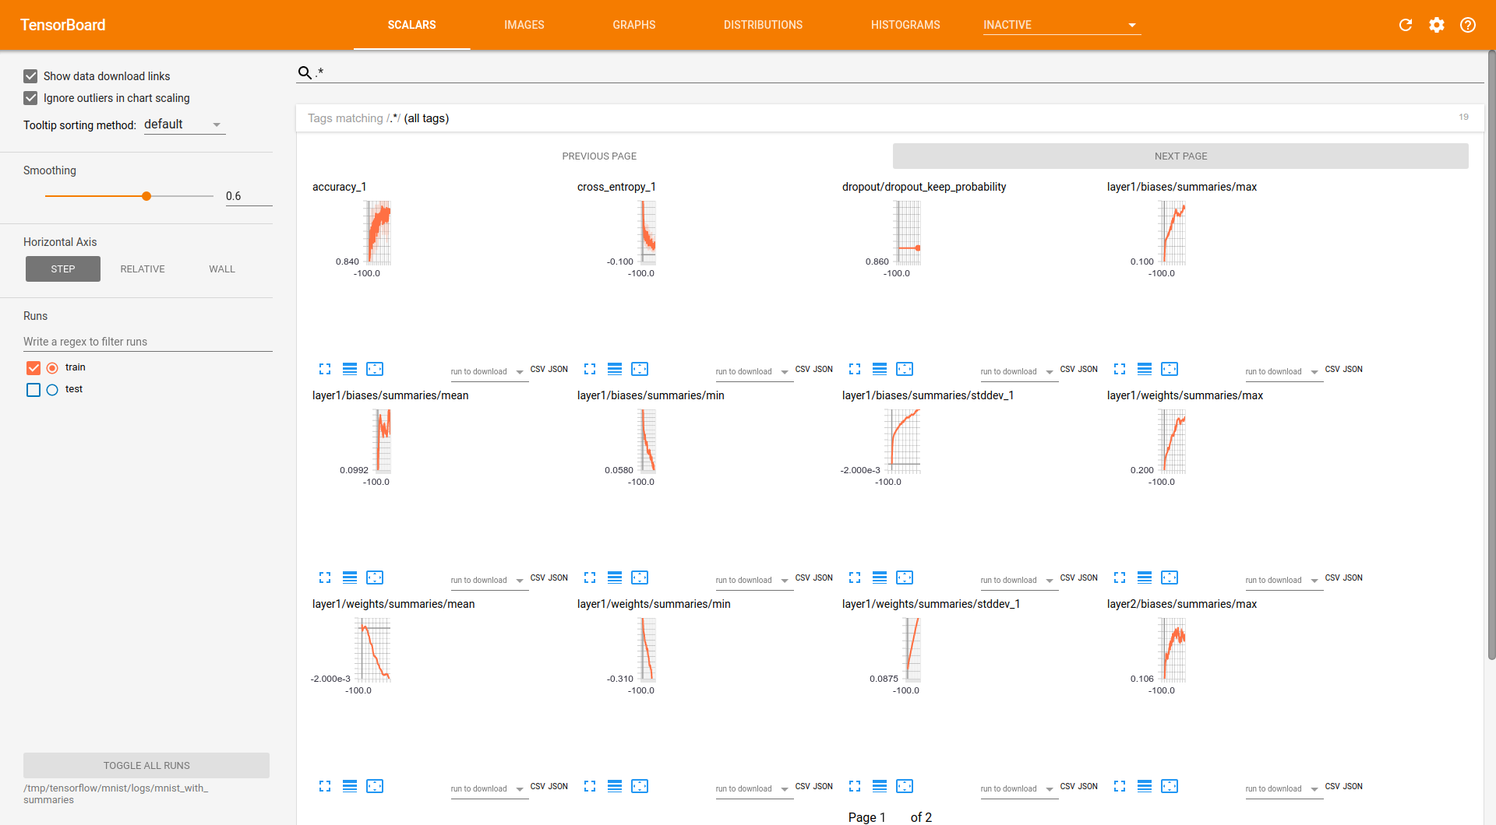
How It Works
Azure Machine Learning
Ray Cluster
Simulator Cluster
Head Node (Training)
Data Scientist Submits Experiment
Worker Node
Simulator Node
Worker
Worker
Sim
Sim
Worker Node
Simulator Node
Worker
Worker
Sim
Sim
Training Results

Slide 6
Requirements
100’s of parallel simulations
Training: multiple days
Multiple Ray jobs
Resilient to simulator / worker failures
ML Ops pipeline integration

Slide 7
Simulators
Open AI Gym
Custom simulators with Open AI Gym Environment interface – worker local or remote in simulator
Windows support
Investigating additional simulator support

Slide 8
Roadmap
Private Preview: Now
Windows Simulators: December
Public Preview: 1HCY20

Slide 9
Demo

Slide 10

How to Set Up
Clone https://github.com/marabout2015/azureml-rl-preview
Go into azureml-rl-preview
Execute conda env create -f environment.yml conda activate azureml-rl-preview jupyter notebook

Slide 11
Running Examples
Run Workspace Setup.ipynb to create a workspace
Run Rllib Pong.ipynb to verify the set up

Slide 12
Learnings
About Azure ML reinforcement learning (RL) module
How to install the module and examples
How to run the examples

Slide 13
Next Steps
Learn about Ray/Rllib
O’Reilly AI tutorial: Scalable AI and reinforcement learning with Ray
http://aka.ms/mslibrary
Create examples using Ray/Rllib
Start by running tutorial examples on AMLS?

Slide 14
Thank you!
Questions?

